Slide 1
Romania – Republic of Serbia IPA Cross-border Cooperation Programme
Programming Languages
Lecturer: lect. dr. eng. Razvan BOGDAN
Notes:
Slide 1: Hello everyone and welcome to programming languages course.

Slide 2
Programming Languages
Lecture 5
Iteration
Notes:
Slide 2: In this lecture we are going to talk about Loops and Iteration.

Slide 3
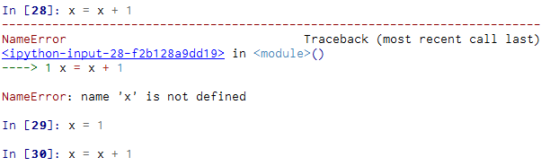
Updating variables
Before you can update a variable, you have to initialize it
If you try to update a variable that doesn’t exist, you get an error
Updating a variable by adding 1 is called an increment; subtracting 1 is called a decrement
Notes:
Slide 3: Updating variables:
A common pattern in assignment statements is an assignment statement that updates a variable - where the new value of the variable depends on the old. So for example we have x = x + 1. This means “get the current value of x, add one, and then update x with the new value.” But if you try to update a variable that doesn’t exist, you get an error, because Python evaluates the right side before it assigns a value to x. So, before you can update a variable, you have to initialize it, usually with a simple assignment.

Slide 4
The while statement
Program:
n = 5
while n > 0 :
print n
n = n – 1
print ‘Out :)'
print n
Output:
5
4
3
2
1
Out :)
0
n = 5
No
n > 0 ?
Yes
print n
n = n -1
1. Evaluate the condition, yielding True or False.
2. If the condition is false, exit the while statement and continue execution at the next statement.
3. If the condition is true, execute the body and then go back to step 1.
print ‘Out :)'
Notes:
Slide 4:The while statement:
Giving the fact that iteration is so common when writing computer programs, Python provides several language features to make it easier. One form of iteration in Python is the while statement. Here is a simple program that counts down from five and then says “Out”. Reading the while from this example means: “While n is greater than 0, display the value of n and then reduce the value of n by 1. When you get to 0, exit the while statement and display the word Out”.
More formally, here is the flow of execution for a while statement:
1. Evaluate the condition, yielding True or False.
2. If the condition is false, exit the while statement and continue execution at
the next statement.
3. If the condition is true, execute the body and then go back to step 1.
This type of flow is called a loop because the third step loops back around to the top. Each time we execute the body of the loop, we call it an iteration. For the above loop, we would say, “It had five iterations” which means that the body of the loop was executed five times.
The body of the loop should change the value of one or more variables so that eventually the condition becomes false and the loop terminates. We call the variable that changes each time the loop executes and controls when the loop finishes the iteration variable. If there is no iteration variable, the loop will repeat forever, resulting in an infinite loop.
(Charles Severance, Python for Informatics: Exploring Information)

Slide 5
Infinite loops
n = 1
No
n > 0 ?
Yes
n = 1
while n > 0 :
print 'Lather’
print 'Rinse'
print 'Dry off!'
print 'Lather'
print 'Rinse'
print 'Dry off!'
Notes:
Slide 5:Infinite loops:
Sometimes when there is no iteration variable, a loop will be infinite. This means that the code from the loop will be executed infinitely. This is the case with the example from this slide. The question to be raised in this point is what kind of mechanism do we have in Python to avoid staying in such a loop.

Slide 6
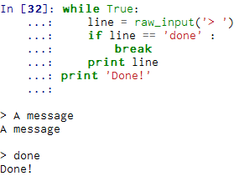
Breaking Out of a Loop
The break statement ends the current loop and jumps to the statement immediately following the loop
It is like a loop test that can happen anywhere in the body of the loop
Notes:
Slide 6: Breaking Out of a Loop:
Sometimes you don’t know it’s time to end a loop until you get half way through the body. In that case you can write an infinite loop on purpose and then use the break statement to jump out of the loop. For example, suppose you want to take input from the user until they type done. You could write something like the example starting on line 32 on the slide. The loop condition is True, which is always true, so the loop runs repeatedly until it hits the break statement.
Each time through, it prompts the user with an angle bracket. If the user types done, the break statement exits the loop. Otherwise the program echoes whatever the user types and goes back to the top of the loop.
(Charles Severance, Python for Informatics: Exploring Information)

Slide 7
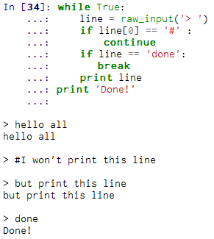
Finishing an iteration with continue
The continue statement ends the current iteration and jumps to the top of the loop and starts the next iteration
Notes:
Slide 7: Finishing an iteration with continue:
Sometimes you are in an iteration of a loop and want to finish the current iteration and immediately jump to the next iteration. In that case you can use the continue statement to skip to the next iteration without finishing the body of the loop for the current iteration.
As an example we will write a loop that copies its input until the user types “done”, but treats lines that start with the hash character as lines not to be printed. So basically the line starting with hash won’t be printed because the continue statement ends the current iteration and jumps back to the while statement in order to start the next iteration. You can see that in this case, the print statement is practically skipped.

Slide 8
Definite loops using for
definite loops execute an exact number of times
use the Python for construct
we say that "definite loops iterate through the members of a set"
friends = ['John', ‘Mary', ‘Joe']
for friend in friends :
print 'Happy New Year:', friend
print 'Done!'
Happy New Year: John Happy New Year: Mary
Happy New Year: Joe
Done!
Notes:
Slide 8: Definite Loops:
Quite often we have a list of items of the lines in a file - effectively a finite set of things. We can write a loop to run the loop once for each of the items in a set using the Python for construct. These loops are called "definite loops" because they execute an exact number of times. We say that "definite loops iterate through the members of a set“.
In the presented example, the variable friends is a list of three strings and the for loop goes through the list and executes the body once for each of the three strings in the list resulting in the presented output. This example basically runs the statements in the body of the for loop once for each friend in the set named friends. For and in are reserved Python words and friend is the iteration variable for the for loop. The variable friend changes for each iteration of the loop and controls when the for loop completes. The iteration variable steps successively through the three strings stored in the friends variable which are John, Mary and Joe.

Slide 9
Loop patterns
Initializing one or more variables before the loop starts.
Performing some computation on each item in the loop body, possibly changing the variables in the body of the loop.
Looking at the resulting variables when the loop completes.
Notes:
Slide 9: Loop patterns:
Often we use a for or while loop to go through a list of items or the contents of a file and we are looking for something such as the largest or smallest value of the data we scan through.
These loops are generally constructed by:
• Initializing one or more variables before the loop starts.
• Performing some computation on each item in the loop body, possibly changing the variables in the body of the loop.
• Looking at the resulting variables when the loop completes. (Charles Severance, Python for Informatics: Exploring Information)
Following next, we will use a list of numbers to demonstrate the concepts and construction of these loop patterns.

Slide 10
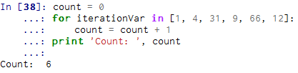

Loop patterns. Counting and summing loops
count the number of items in a list
compute the total of a set of numbers
len()
sum()
https://docs.python.org/2/library/functions.html
Notes:
Slide 10: Loop patterns. Counting and summing loops:
The first example we will refer to, will count the number of items in a list. So we will write a for loop as you can see on the slide starting with line [38].
First of all, we will set the variable count to zero before the loop starts. On the next line, we will write a for loop to run through the list of numbers. The iteration variable is called iterationVar. This variable will cause the loop body to be executed once for each of the values in the list as long as we do not use iterationVar in the loop. So this variable is kind of controlling the loop.
In the body of the loop, we will add one to the current value of count for each of the values in the list. As long as the the loop is executing, the value of count is the number of values we have encounter until now. Once the loop completes, the value of count is the total number of items.
Another example that we refer to is about computing the total of a set of numbers and is presented starting with line [39] on the slide. The main difference between the first example and this one is that the iteration variable will be used in the loop (see animation). So, instead of simply adding one to the count as in the previous loop, we add the actual number (which is 1, 4, 31, and so on) to the
running total total during each loop iteration. If you think about the variable total, it contains the “running total of the values so far”.
As you can see, before starting the loop, the total variable is zero because we have not yet seen any values; during the loop, total is the running total, and at the end of the loop total is the overall total of all the values in the given list.
Neither the counting loop nor the summing loop are particularly useful in practice because there are built-in functions len() and sum() (see animation) that actually compute the number of items in a list and the total of the items in the list respectively. For more information on that please see the link.

Slide 11
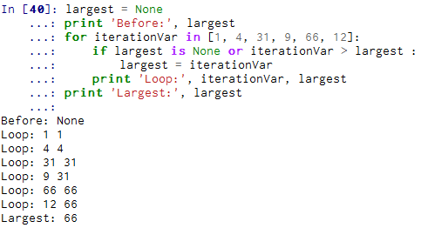
Loop patterns. Maximum and minimum loops
find the largest value in a list or sequence
max()
https://docs.python.org/2/library/functions.html
Notes:
Slide 11: Loop patterns. Maximum and minimum loops:
In order to find the largest value in a list or sequence we can construct a loop as the one presented on the slide.
The variable largest is best thought of as the “largest value we have encountered so far”. So, before the loop, we set largest to the constant None. None is a special constant value which we can store in a variable to mark the variable as “empty”. (Charles Severance, Python for Informatics: Exploring Information)
Before the loop starts, the largest value we have seen so far is None since we have not yet encountered any values. While the loop is executing, if largest is None then we take the first value we see as the largest so far. You can see in the first iteration when the value of iterationVar is 1, since largest is None, we immediately set largest to be 1.
After the first iteration, largest is no longer None (it will be 1), so the second part of the compound logical expression that checks iterationVar > largest triggers only when we see a value that is larger than the “largest so far” (in our case, 1). When we see a new larger value than the largest so far, then we take that new value for largest. You can see in the program output that largest progresses from 1 to 4 to 31 and so on. At the end of the loop, we have scanned all of the values from our set and the variable largest now does contain the largest value in the list.
A built-in function for our small example is offered by Python in the form of max() function.

Slide 12
Loop patterns. Maximum and minimum loops
compute the smallest number
min()
https://docs.python.org/2/library/functions.html
Notes:
Slide 12: Loop patterns. Maximum and minimum loops:
Now, to compute the smallest number, the smallest variable is the “smallest so far” before, during, and after the loop executes.
When the loop has completed, smallest contains the minimum value in the list. Also, a built-in function for our example is offered by Python in the form of min() function. Check more on this on the given link.

Slide 13
The "is" and "is not" Operators
Python has an "is" operator that can be used in logical expressions
Implies 'is the same as'
Similar to, but stronger than ==
'is not' also is a logical operator
Notes:
Slide 13: The "is" and "is not" Operators:
You might have noticed in our previous examples that we used a special operator which is the ‘is’ operator. This can be used in logical expressions, meaning 'is the same as‘ and being similar to, but stronger than ==. There is also the ‘is not’ operator which is also a logical operator.

Slide 14
Homework
Write a program which repeatedly reads numbers until the user enters “done”. Once “done” is entered, print out the total, count, and average of the numbers. If the user enters anything other than a number, detect their mistake using try and except and print an error message and skip to the next number.
Enter a number: 4
Enter a number: 5
Enter a number: bad data
Invalid input
Enter a number: 7
Enter a number: done
Notes:
Slide 14: Homework: As homework, here is an exercise that you are invited to solve, based on your knowledge you have gained so far and especially during this course on loops and iteration. Also, try solving the examples presented in the course by working them out in Canopy. Good luck and thank you very much for watching this course! ☺

